Slide 1
What are mutational signatures and why do we need experimental elucidation?
Arnoud Boot
Juli 11th 2020

Slide 2
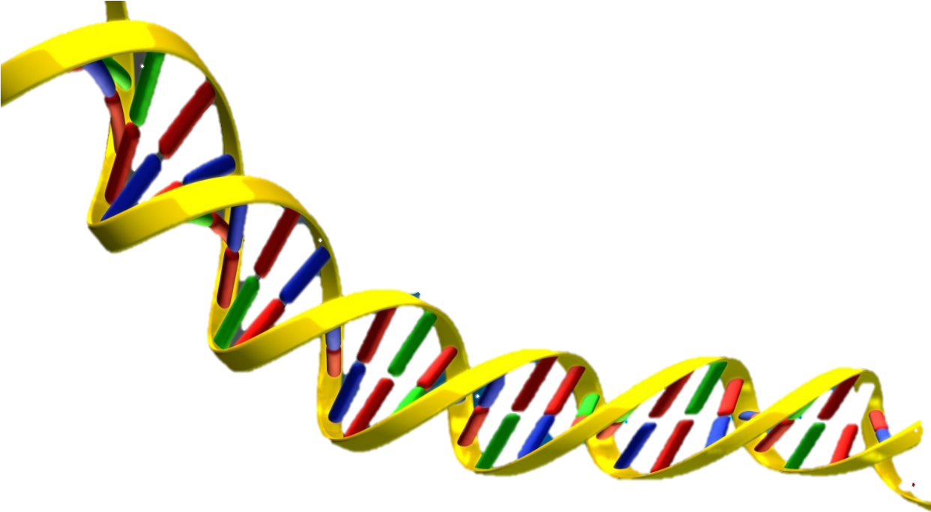
Mutagenesis leads to tumorigenesis
Mutagenesis is associated with tumorigenesis.
Besides random mutagenesis that occurs during cell division, cells are often also subjected to other sources of mutagenesis.
Mutagenesis can be endogenous (cytosine deamination, MMR deficiency) or exogenous (aflatoxin exposure, UV-mutagenesis).
Each mutagenic process leaves its own characteristic pattern of mutations;
its mutational signature.
clipartmax.com

Slide 3
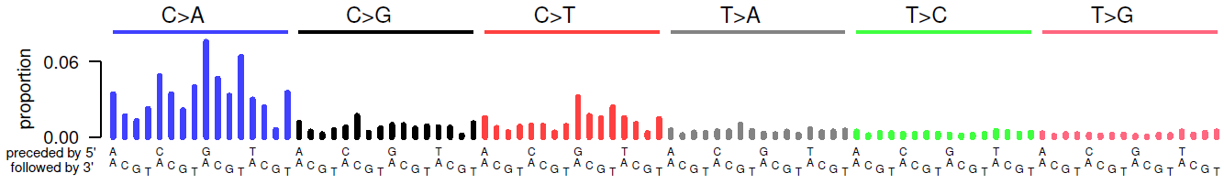
What does a mutational signature look like?
Mutational signatures are a visual display of the frequency of a single nucleotide substitution (SNS) in trinucleotide context.
Aflatoxin B1 (AFB1) mutational signature:
AFB1 covalently binds the N-7 position of guanine
AFB1 exposed cells show mainly G>T (= C>A) mutations

Slide 4
Types of mutational signatures
Alexandrov et al., Nature, 2020
https://cancer.sanger.ac.uk/cosmic/signatures

Slide 5
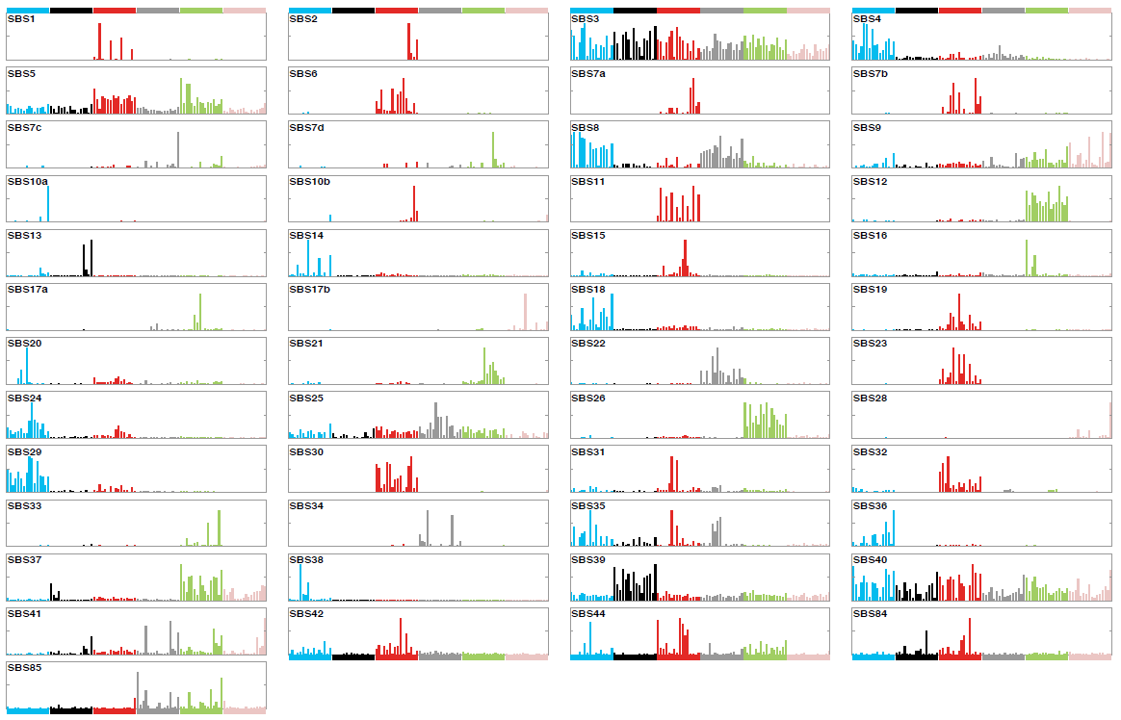
Known mutational signatures
Alexandrov et al., Nature, 2020
https://cancer.sanger.ac.uk/cosmic/signatures

Slide 6
Known mutational signatures (endogenous)

Slide 7
Known mutational signatures (exogenous)

Slide 8
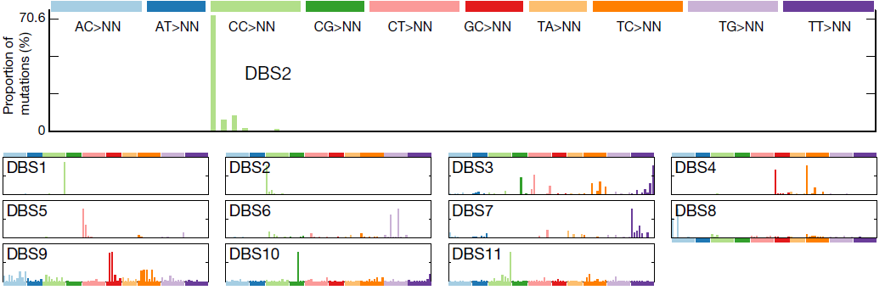
Known DBS signatures

Slide 9
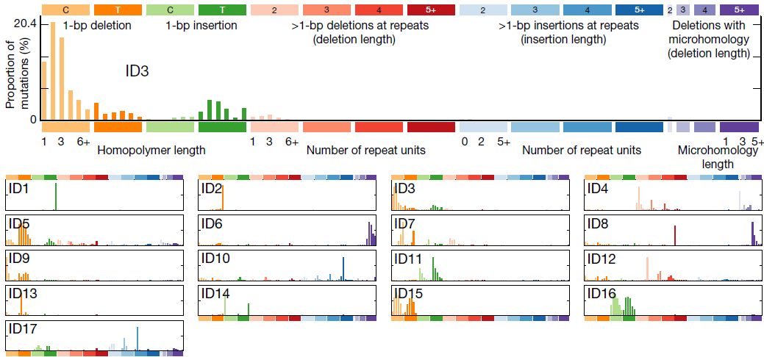
Known ID signatures

Slide 10
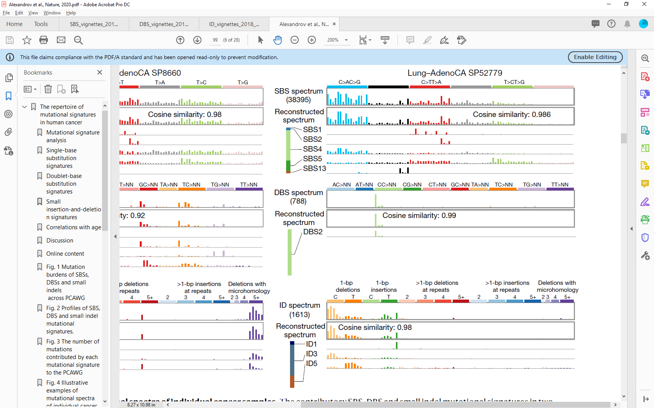
Reconstructing mutational spectra
Mutation spectra are a combination of multiple mutational processes

Slide 11
Reconstructing mutational spectra
Mutation spectra are a combination of multiple mutational processes

Slide 12
Reconstructing mutational spectra
Mutation spectra are a combination of multiple mutational processes

Slide 13
Mutographs
Mutational processes can cause several types of mutations

Slide 14
What shapes mutational signatures?
Mutational signature formation is a multistep process:
WT sequence
DNA damage occurs on 3rd base
DNA repair fails, damage persists
Mis-incorporation opposite damage
Second round of DNA replication
ACGTTGTA
*
ACGTTGTA
*
ACGTTGTA
*
ACGTTGTA
TGAAACAT
ACTTTGTA
TGAAACAT

Slide 15
What shapes mutational signatures?
Mutational signature formation is a multistep process: Potential sources that can modify
the resulting mutational signature
WT sequence
DNA damage occurs on 3rd base DNA damage could be sequence specific
DNA repair fails, damage persists DNA repair proficiency can depend
on sequence context
Mis-incorporation opposite damage There are 4 possibilities
Second round of DNA replication Before this step; the mismatch existing
ACGTTGTA
*
ACGTTGTA
*
ACGTTGTA
*
ACGTTGTA
TGAAACAT
ACTTTGTA
TGAAACAT
Notes:
TLS: translesion synthesis; DNA replication over a damaged base which is performed by specialized DNA polymerases. TLS DNA polymerases have larger binding pockets, thus allowing damaged bases to fit. As a result of this, the basepairing is lower fidelity, causing mis-incorporation opposite damaged bases.

Slide 16
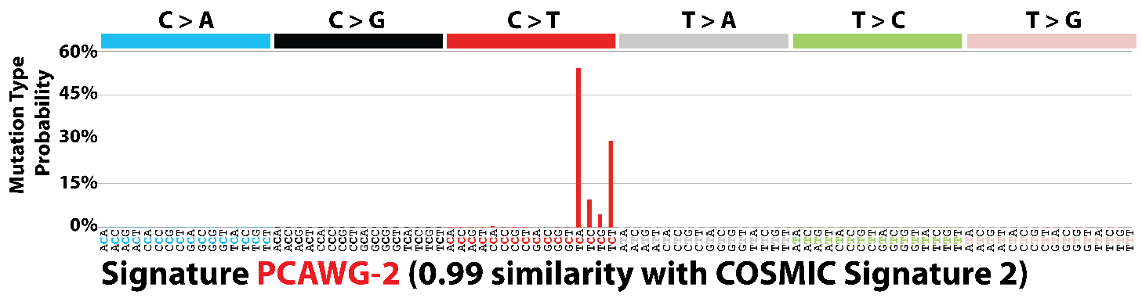
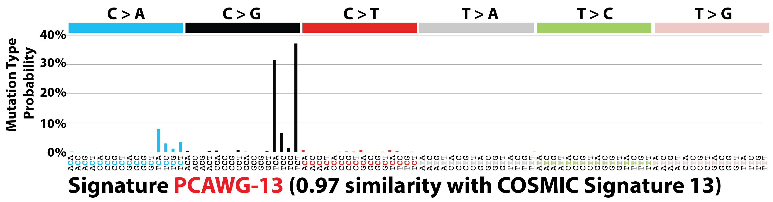
Example of how mutational signature are shaped: APOBEC
A
B
Mutational process
DNA damage
DNA repair
TLS
APOBEC deamination
C → U
APOBEC deamination
C → U
No DNA repair
BER creates abasic site
No TLS invoked
DNA replication by polymerase ϵ
TLS 1 (e.g. POLα)
TLS 2 (e.g. REV1)
SBS2
C>T
C>G
SBS13
Notes:
BER: Base-excision repair, a DNA repair pathway that excises single damaged bases from
polymerases alpha preferentially inserts A, leading to C>T substitutions (TLS1)
TLS polymerase REV1 preferentially inserts C, leading to C>G substitutions (TLS2)

Slide 17
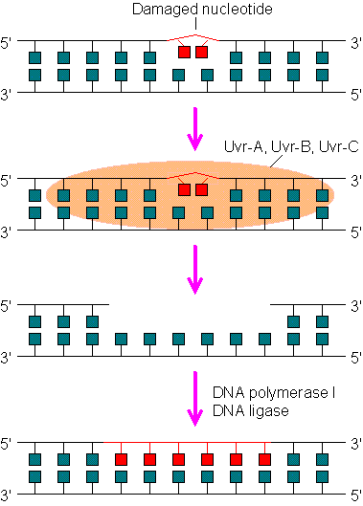
DNA repair in mutational signature research: TC-NER
Sometimes DNA repair can give us information on the damage underlying mutational signatures
TC-NER specializes in removing large adducts (e.g. UV)
As it is only invoked when transcription machinery encounters such an adduct, the resulting mutagenesis shows evidence of TC-NER involvement
Notes:
TC-NER: transcription-coupled nucleotide excision repair

Slide 18
DNA repair in mutational signature research: TC-NER
Sometimes DNA repair can give us information on the damage underlying mutational signatures
TC-NER specializes in removing large adducts (e.g. UV)
As it is only invoked when transcription machinery encounters such an adduct, the resulting mutagenesis shows evidence of TC-NER involvement
Transcriptional strand bias can also inform on the adducted base
Notes:
TC-NER: transcription-coupled nucleotide excision repair

Slide 19
Role of mutational signatures in research
Mutational Signatures
Molecular cancer epidemiology
How do mutations cause cancer?
Understanding
of DNA damage and repair
Prevention and screening
Cancer life histories and signature-associated oncogenic pathways
Application
Specific therapeutic opportunities

Slide 20
Role of mutational signatures in research
Discovery
Analysis of large databases
Experimental elucidation
Mutational Signatures
Molecular cancer epidemiology
How do mutations cause cancer?
Understanding
of DNA damage and repair
Prevention and screening
Cancer life histories and signature-associated oncogenic pathways
Application
Specific therapeutic opportunities

Slide 21
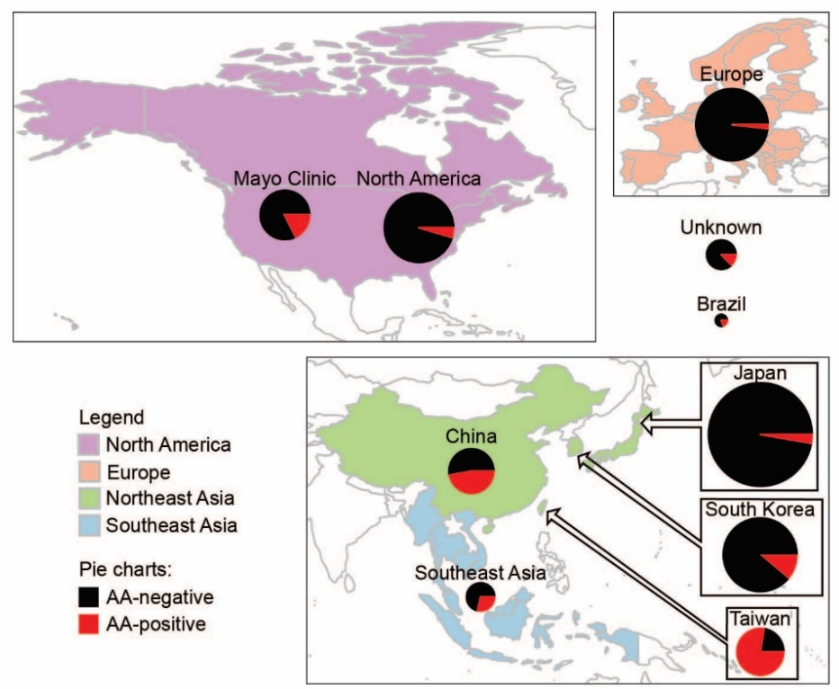
Applications of mutational signatures: Prevention and screening
Mutational signature research can identify hazards
Identification of novel mutational processes can inform on (preventable) exposures contributing to tumorigenesis
Example: Aristolochic acids
Aristolochic acids are compounds found in species of Aristolochia
and Asarum. Recent publications have revealed aristolochic-acid
associated mutagenesis (SBS22) worldwide.
Example: Colibactin
Colibactin is a compound produce by bacteria carrying the pks
gene island. Colibactin mutagenesis has mainly been observed in
colon, but also in an oral squamous cell carcinoma; this might
have been preventable with better oral hygiene.
Ng et al., STM, 2017
Pleguezuelos-Manzano et al., Nature, 2020
Boot et al., Gen.Res, 2020

Slide 22
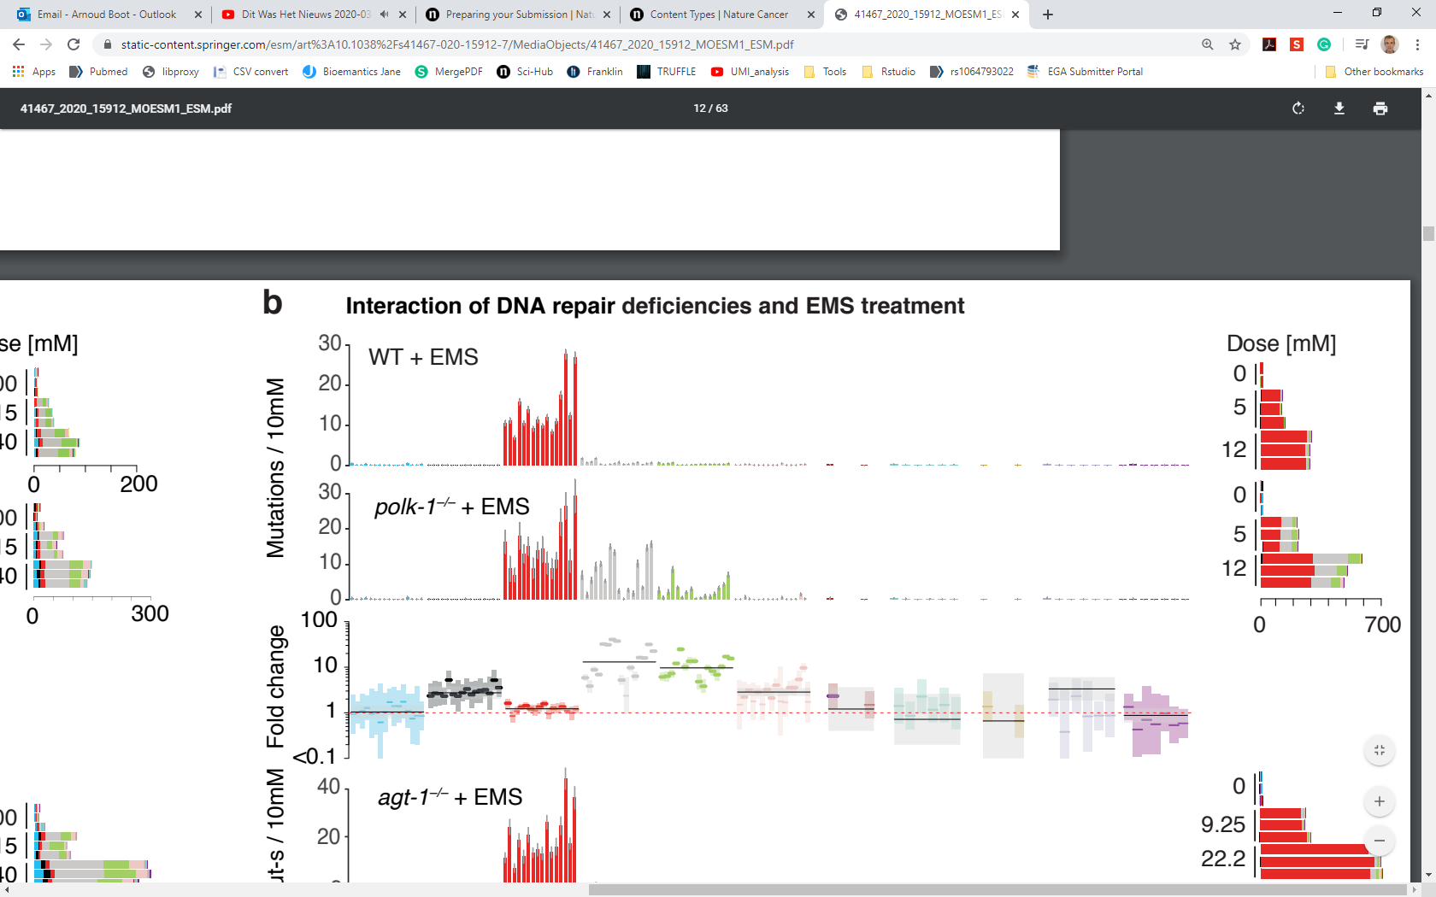
Applications of mutational signatures: Cancer life histories
Mutational signatures cause specific mutations, shaping the driver mutation landscape
Examples:
Aflatoxin B1 (SBS24) is associated with p53 p.R249S
MUTYH deficiency (SBS36) is associated with KRAS p.G12C
The hTERT promoter mutation often observed in melanomas fits the mutational signature of UV-light (SBS7)
Mutational signatures can shed light on how DNA damage and repair functions
Example: Volkova et al.: knockout of POLκ leads to strong T>A and T>C mutagenesis, suggesting POLκ plays a role in TLS over EMS adducts on adenines, but not guanines
Volkova et al., Nat.com, 2020
Notes:
EMS: ethyl methanesulfonate

Slide 23
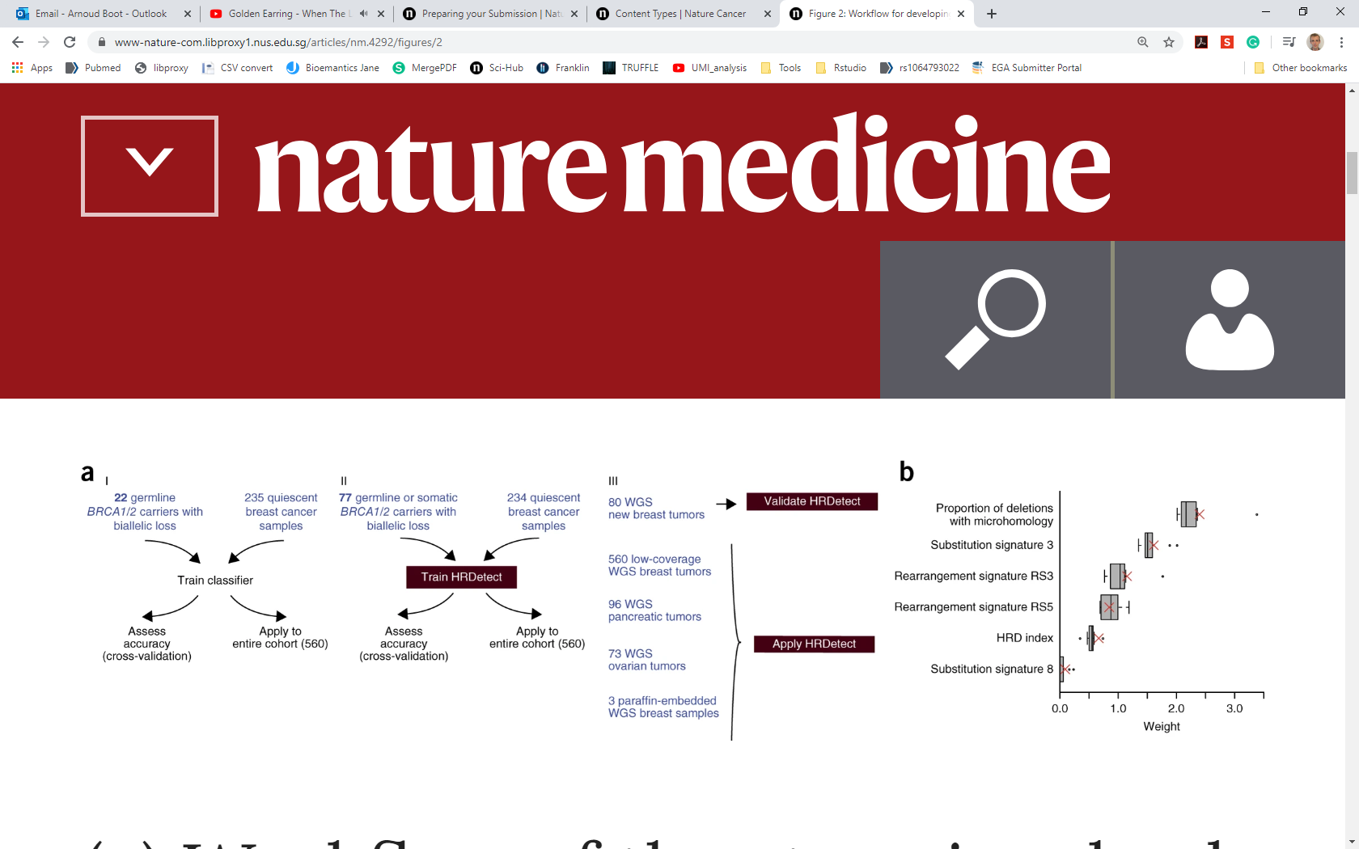
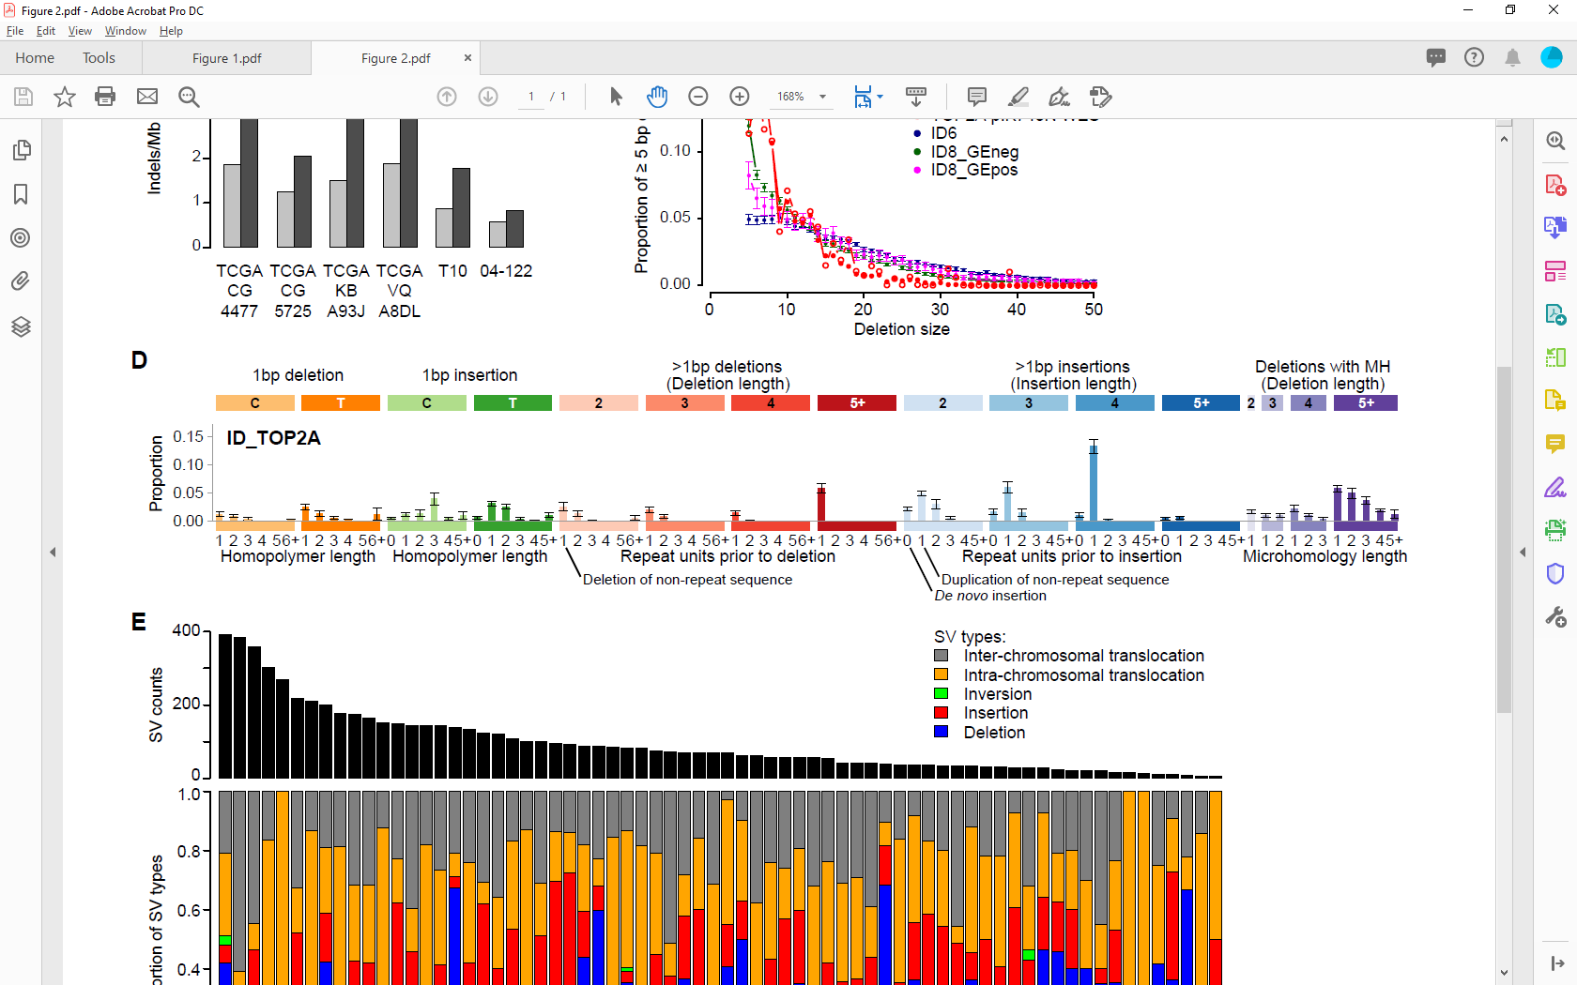
Applications of mutational signatures: Therapeutic opportunities
Mutational signatures can also indicate sensitivity to therapeutic strategies
Example: Presence of SBS3 predicts sensitivity to PARP-inhibitors
Example: TOP2A mutagenesis is indicative of trapped
TOP2 cleavage complexes and could be predictive of
increased sensitivity to TOP2 inhibitors (e.g. etoposide)
Evidence of BRCAness in HR-detect
Davies et al., Nat.med., 2017
Chopra et al., Nat.com, 2020
Boot et al., bioRxiv, 2020
Santial et al., bioRxiv, 2020

Slide 24
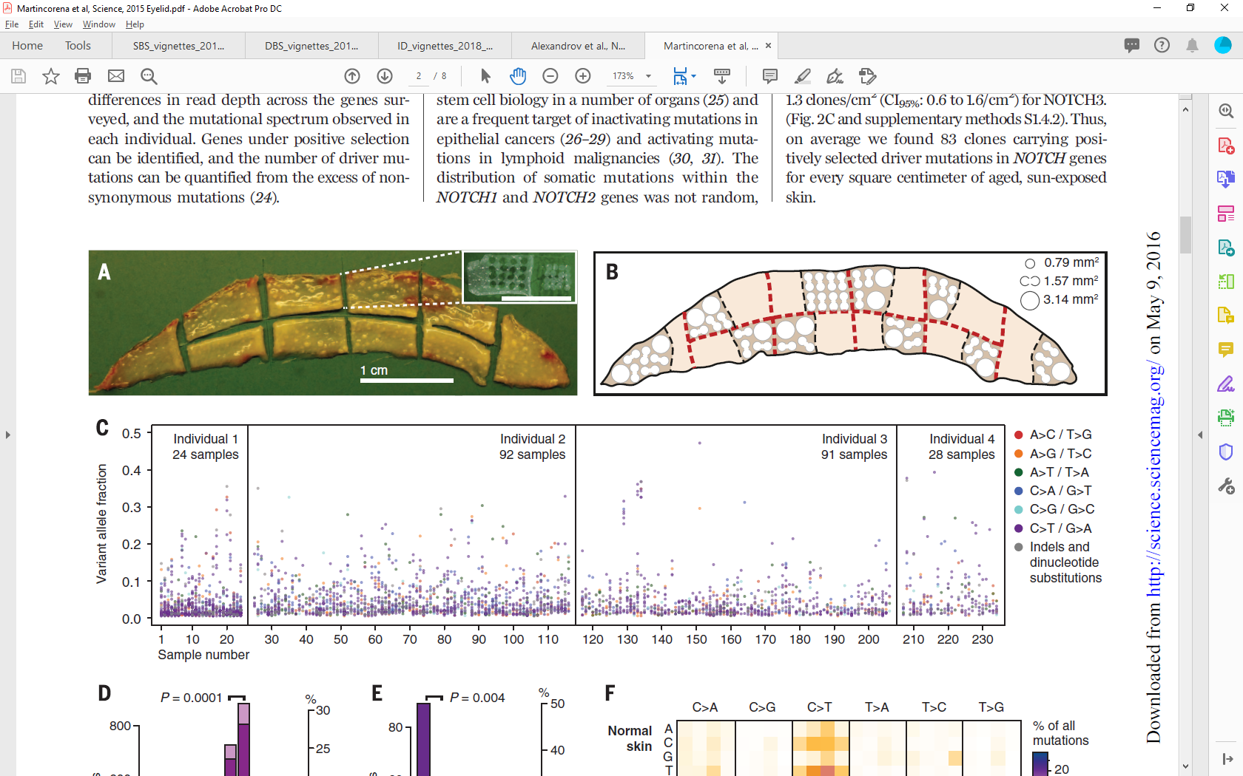
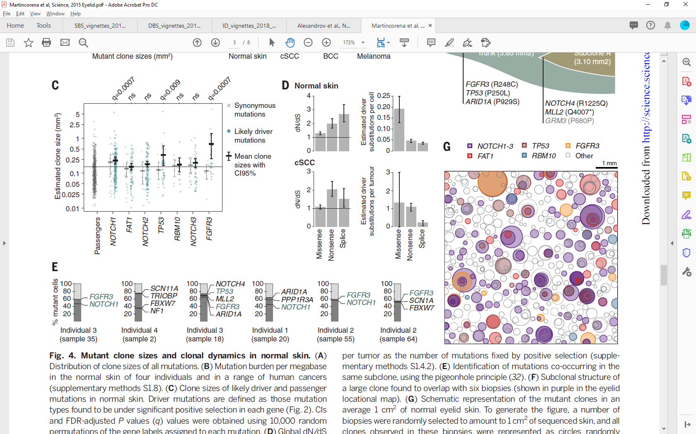
Mutagenesis in normal tissues
Mutagenesis also occurs in histologically normal tissue
All cells accumulate mutations when dividing
Martincorena et al., Science, 2015
Colom et al., Nat.genet, 2020
Naxerova, Nature, 2020

Slide 25
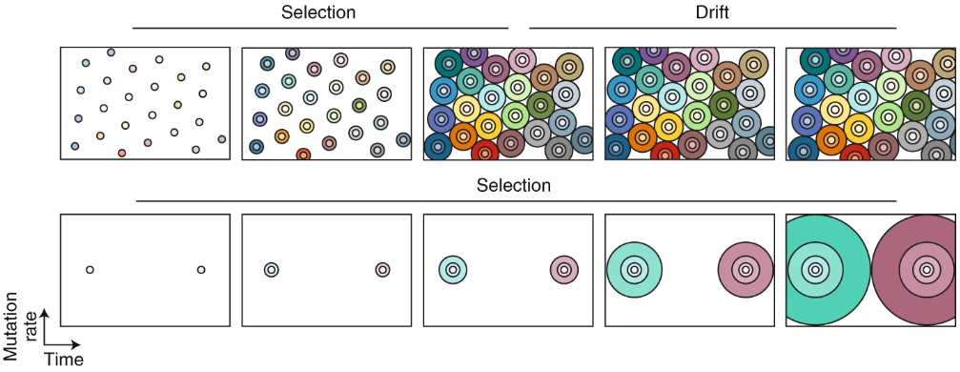
Mutagenesis in normal tissues
Mutagenesis also occurs in histologically normal tissue
All cells accumulate mutations when dividing
Many clones observed in normal tissues have driver mutations,
Colom et al. provided evidence of competition between clones,
keeping them in check.
Martincorena et al., Science, 2015
Colom et al., Nat.genet, 2020
Naxerova, Nature, 2020

Slide 26
Experimental delineation of mutational signatures

Slide 27
Experimental delineation of mutational signatures
Why experimentally delineate mutational signatures
Identify novel mutational signatures
Get a “clean” signature
Establish/confirm etiology of known mutational signatures

Slide 28
Experimental delineation of mutational signatures
Why experimentally delineate mutational signatures
Identify novel mutational signatures
Get a “clean” signature
Establish/confirm etiology of known mutational signatures

Slide 29
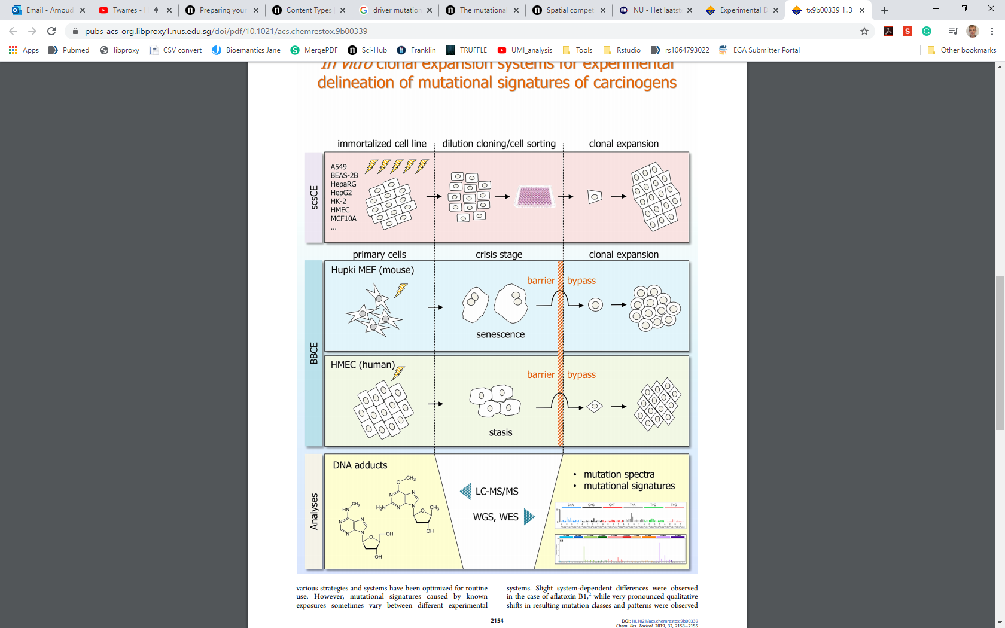
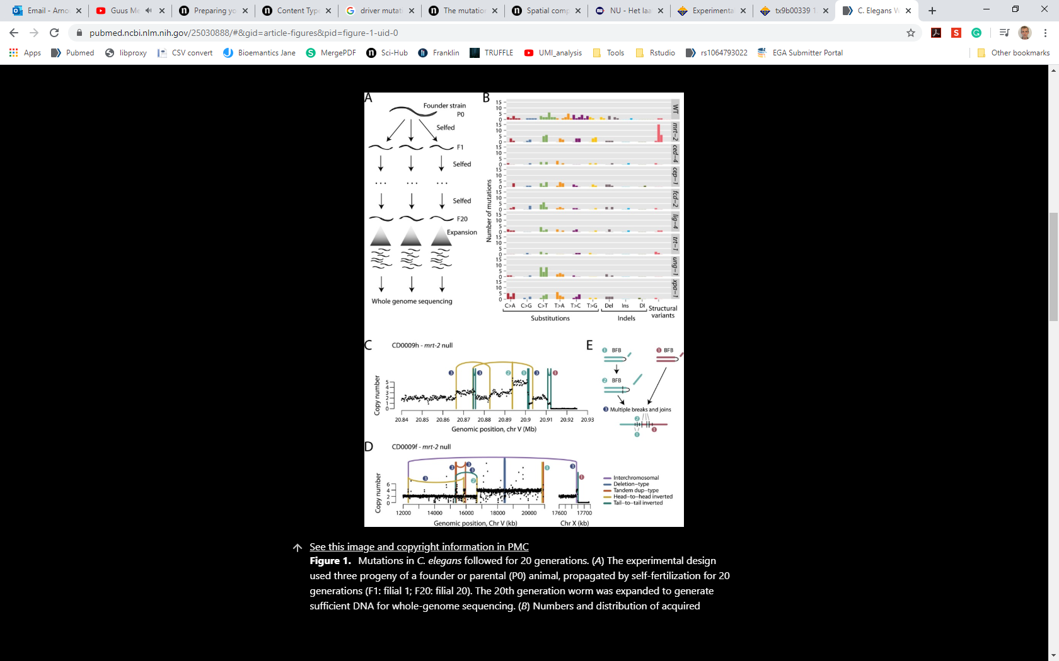
Experimental delineation of mutational signatures
Approaches used:
3 basic approaches:
Immortalized cell line prolonged exposure (e.g. Boot et al.)
Immortalized cell line short exposure (e.g. Kucab et al.)
In vivo exposure(e.g. Meier et al. C. elegans,
Li et al., M. musculus)
Zavadil and Rozen, Chem.Res.Tox, 2019
Boot et al., Gen.Res, 2018
Kucab et al., Cell, 2019
Meier et al., Gen.Res, 2015
Li et al., Nat.com, 2020
Notes:
Pros and Cons to these methods:
Prolonged exposure of human cell lines: time and labor intensive, but background mutations also accumulate
Short exposure of human iPCSs: Much faster, less background mutagenesis, but DNA repair might be different (gene expression in iPSCs is different than adult tissues)
In vivo exposures: model is non-human, thus DNA repair could be different, ethical constraints, for C. elegans, damage has to be in germline.

Slide 30
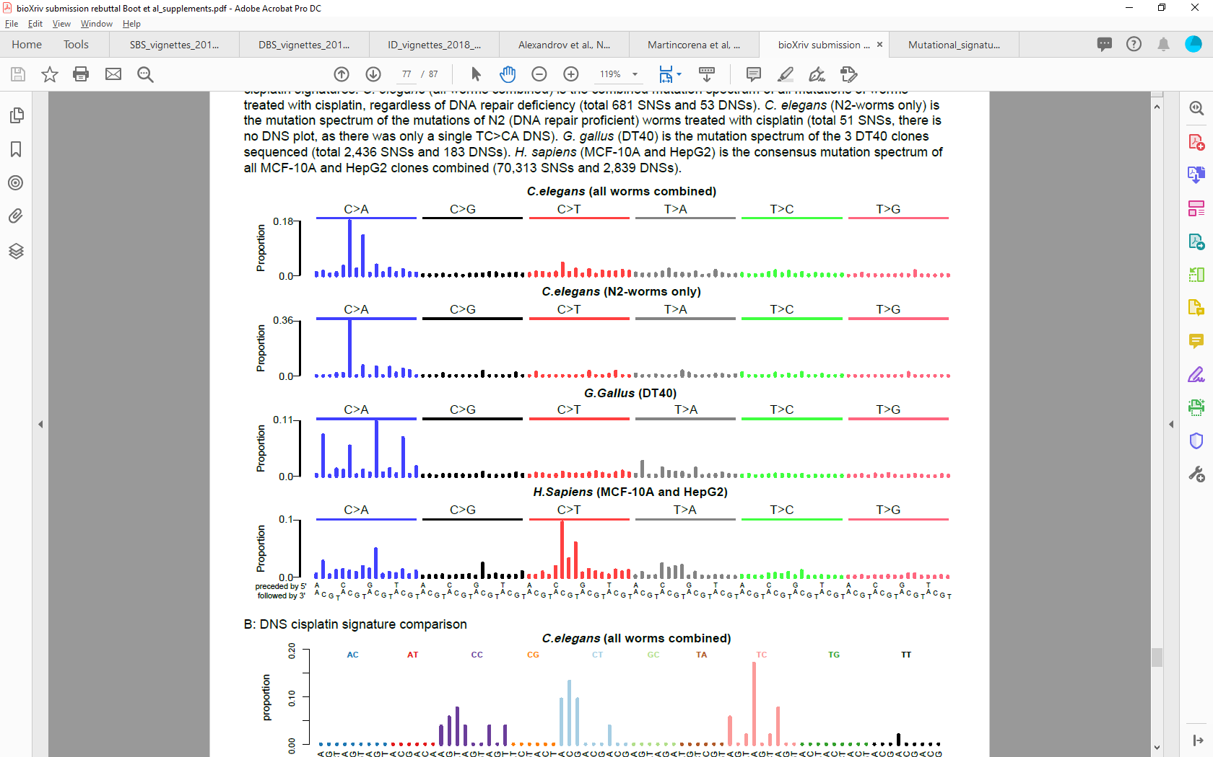
Importance of model selection: DNA repair status
Experimentally delineated cisplatin signature in C. elegans and human cell lines
C. elegans data on other mutational processes closely resembles the human equivalents
CCC
CCT
CCC
CCT

Slide 31
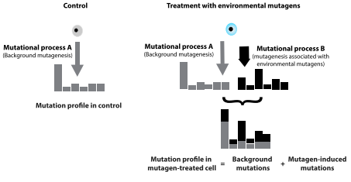
Separating background mutagenesis
All cells accumulate mutations when dividing. This is also true for experimental systems.
Therefore, we need to separate the background mutagenesis from the true signal
Kucab et al., Cell, 2019

Slide 32
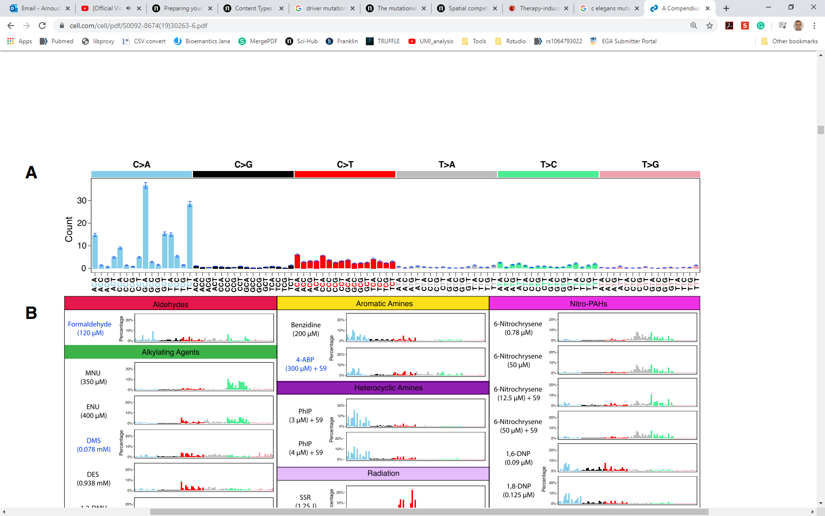
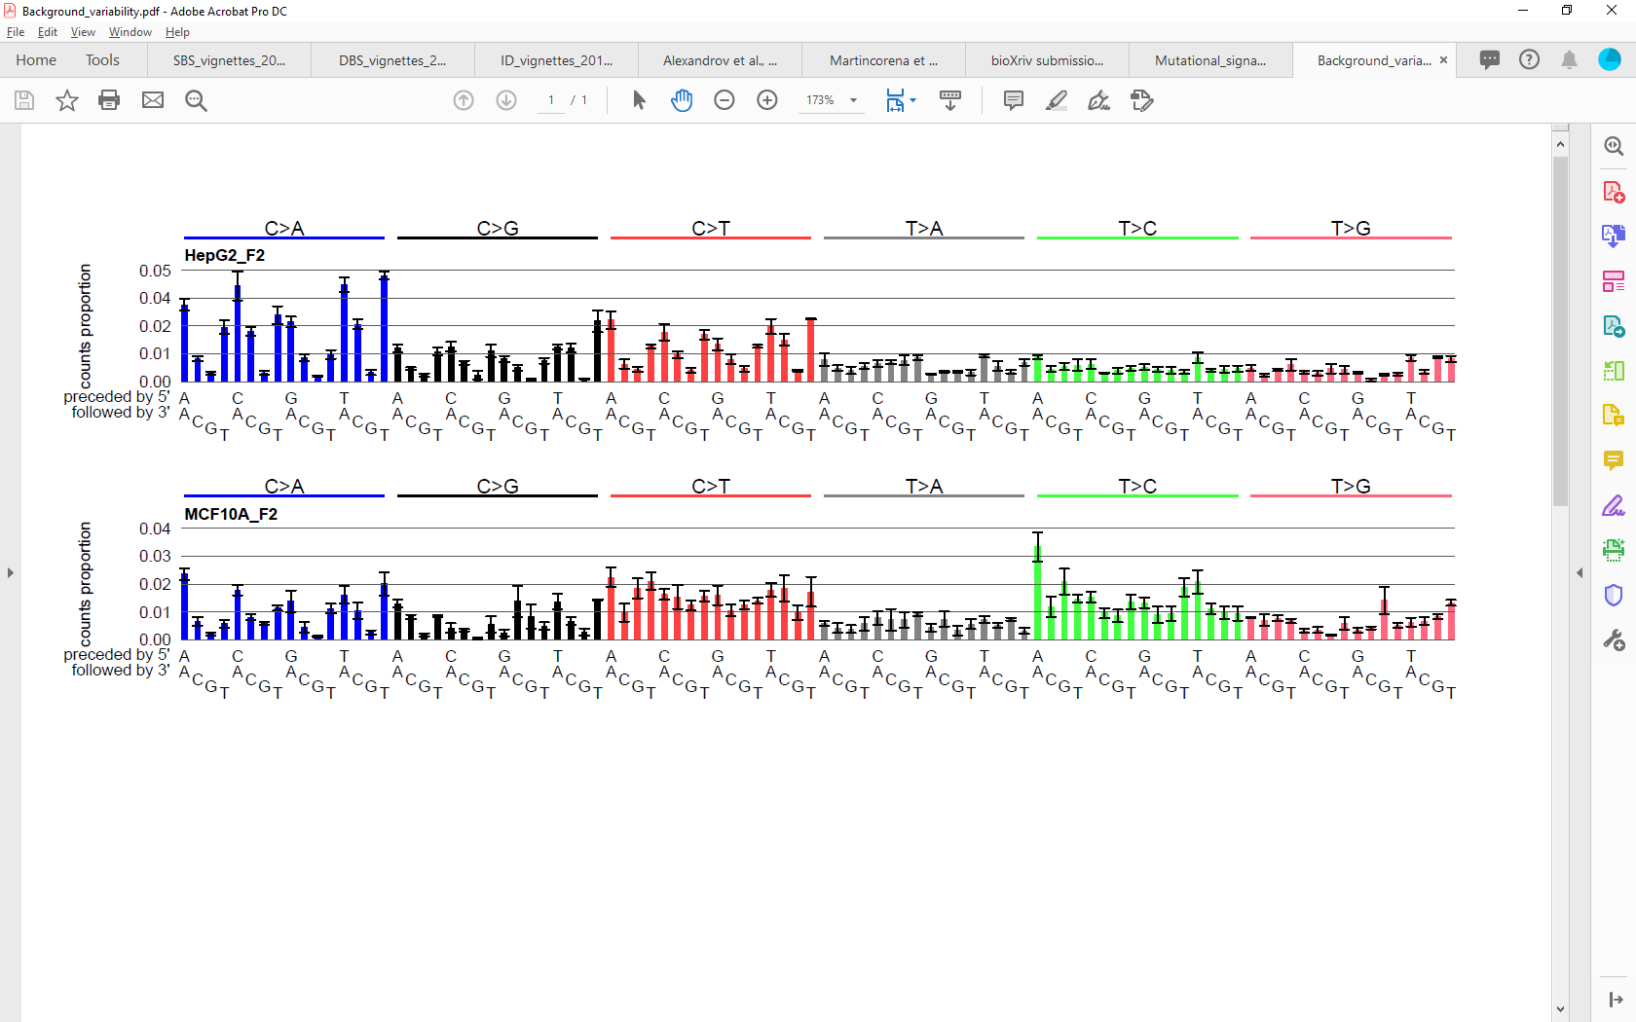
Background mutagenesis depends on the model
Every model has background mutagenesis.
Kucab et al., Cell, 2019,
Boot et al., unpublished data

Slide 33
Separating background mutagenesis (2)
How to determine the level of background mutagenesis
Kucab et al., Cell, 2019

Slide 34
Separating background mutagenesis (2)
How to determine the level of background mutagenesis
What if the mutational signature of a compound resembles the background mutational signature?
Kucab et al., Cell, 2019

Slide 35
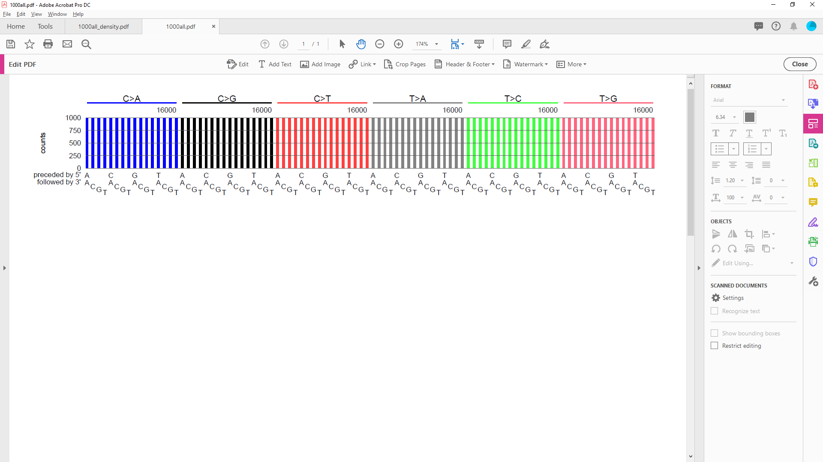
(tri-) nucleotide abundance
Mutational signatures are traditionally displayed in human genome abundance
Why does this matter?
Not all trinucleotides are equally abundant in the human genome
Counts

Slide 36
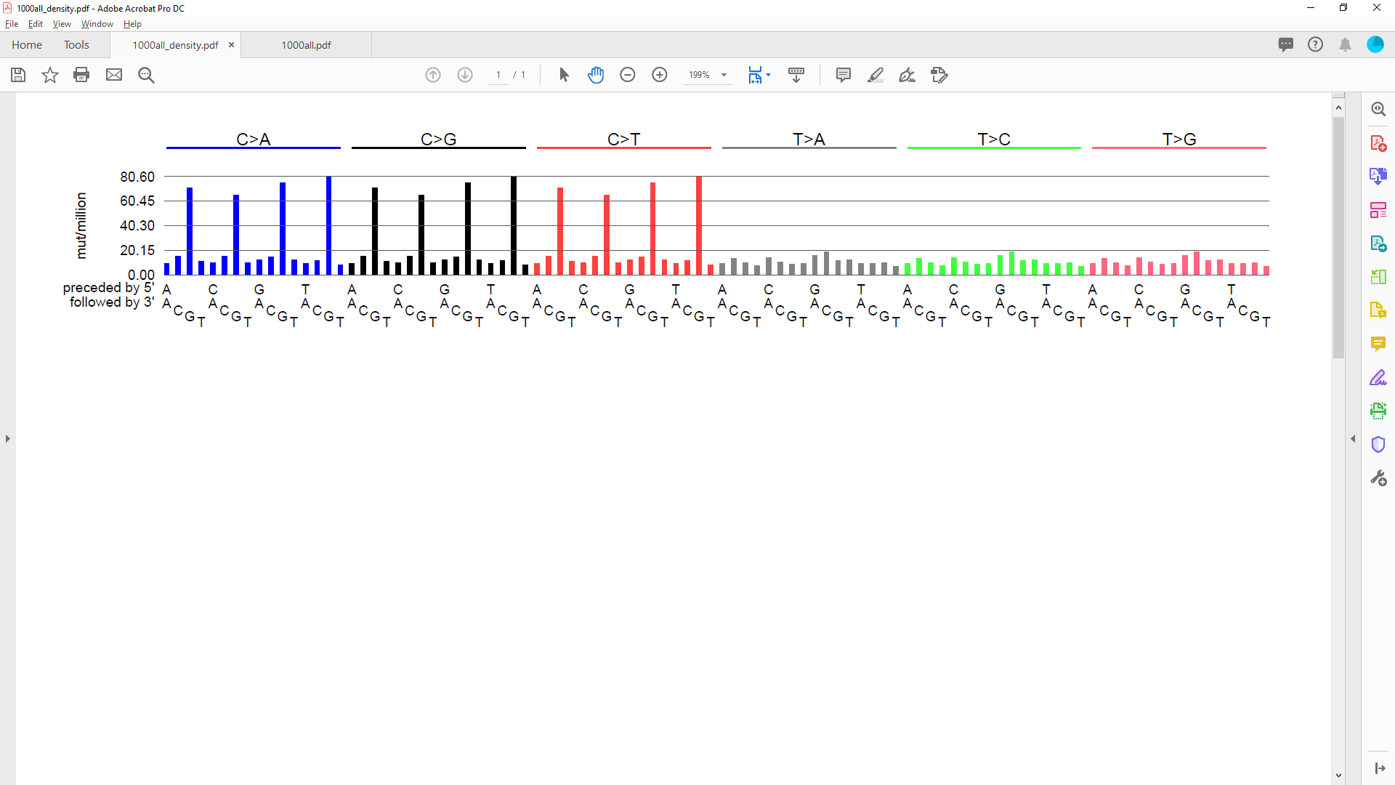
(tri-) nucleotide abundance
Mutational signatures are traditionally displayed in human genome abundance
Why does this matter?
Not all trinucleotides are equally abundant in the human genome
Counts
Density

Slide 37
(tri-) nucleotide abundance
Mutational signatures are traditionally displayed in human genome abundance
Why does this matter?
Not all trinucleotides are equally abundant in the human genome
Trinucleotide abundance needs to be taken into account when
Analyzing targeted sequencing data
Analyzing sequencing data from different organisms
Counts
Density

Slide 38
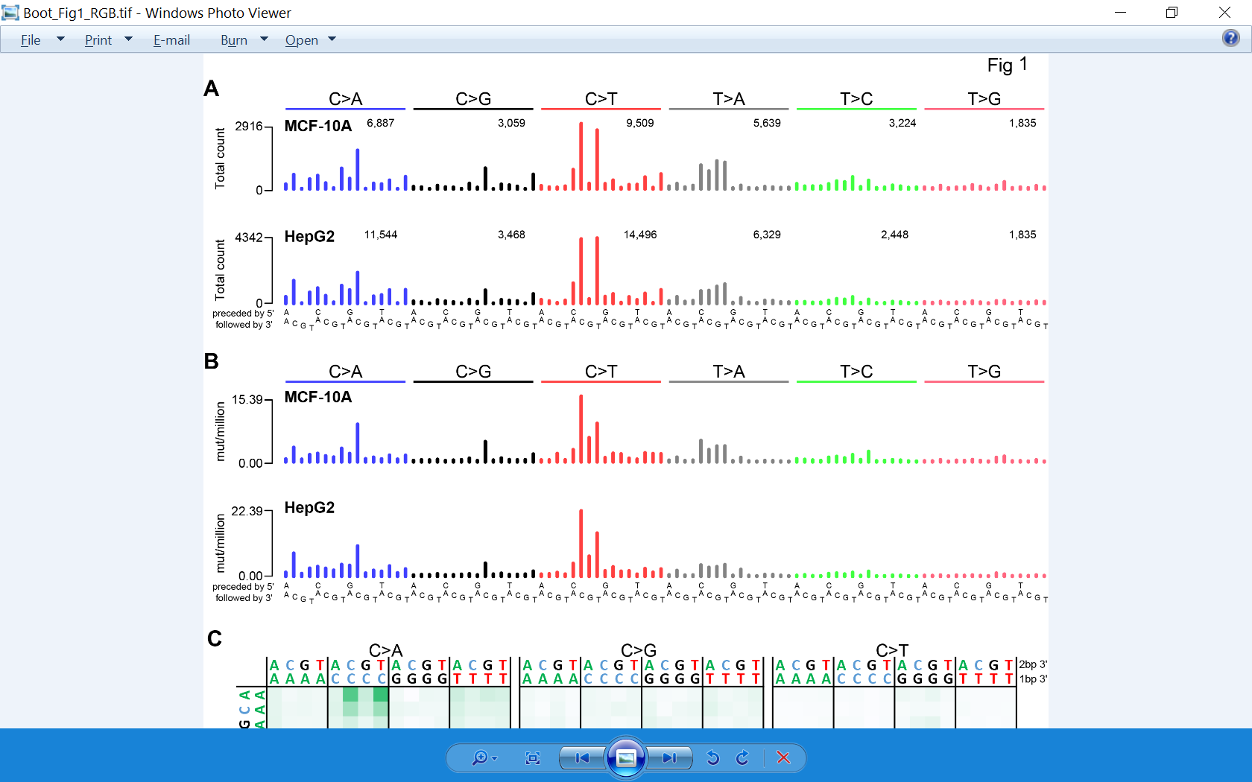
For mechanistic insight, density is more informative
When taking trinucleotide abundance into account, it is clear that CCC>CTC mutations are much more prevalent than CCT>CTT mutations

Slide 39
Some conceptual questions regarding experimental research
Sometimes experiments don’t model biology
Metabolism
Tissue distribution
Mutagenesis sometimes needs a push (e.g. Aflatoxin & Hepatitis)
The time-line of exposure cannot reasonably be modeled

Slide 40
Some conceptual questions regarding experimental research
Sometimes experiments don’t model biology
Metabolism
Tissue distribution
Mutagenesis sometimes needs a push (e.g. Aflatoxin & Hepatitis)
The time-line of exposure cannot reasonably be modeled
Mutagenesis in a model can’t perfectly predict mutagenicity in humans in vivo

Slide 41
Some conceptual questions regarding experimental research
Sometimes experiments don’t model biology
Metabolism
Tissue distribution
Mutagenesis sometimes needs a push (e.g. Aflatoxin & Hepatitis)
The time-line of exposure cannot reasonably be modeled
Mutagenesis in a model can’t perfectly predict mutagenicity in humans in vivo
What if experimental data doesn’t match tumor data

Slide 42
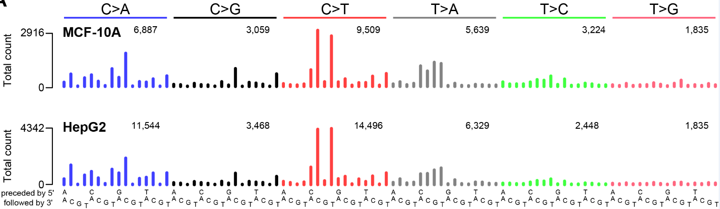
What if experimental data doesn’t match tumor data
Example: Cisplatin
Is there a biological reason why these signatures are split?
Boot et al., Gen.Res 2018
Alexandrov et al., Nature, 2020

Slide 43
Take-away points
Mutational signatures can offer insight into:
Mutagenic processes underlying cancer
Mutagenesis and DNA repair
Inform on treatment strategies
Experimental elucidation can provide valuable information on DNA damage repair and mutagenesis
We must always look for biologically plausible results; it is not a mathematical exercise.

Slide 44


Slide 45
Practical exercise: analyzing experimental signatures data
Aims:
Analyze experimental mutational signature data
Separating signal from background mutagenesis
Questions:
Does background subtraction improve similarity between experimental data and signatures extracted from human tumors?
Is there a difference between the mutational signatures of cisplatin, carboplatin and oxaliplatin?

Slide 46
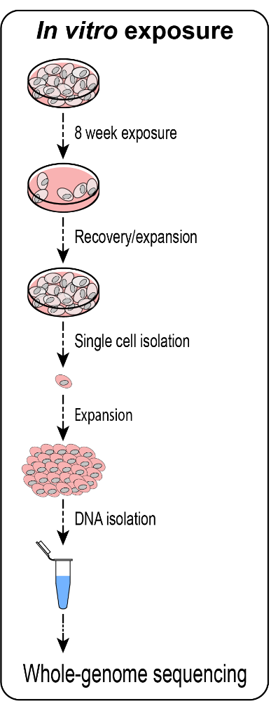
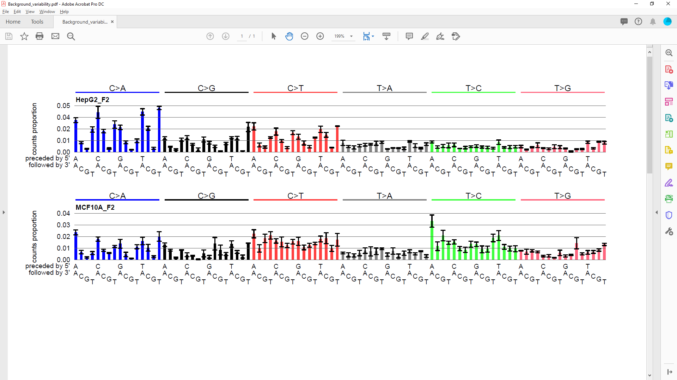
Practical exercise: What is background?
Experimentally determined background
The background object contains:
Background signature (above)
The number of background mutations observed in the clones
Estimated variability of counts due to background
Estimated variability in background signature profile

Slide 47
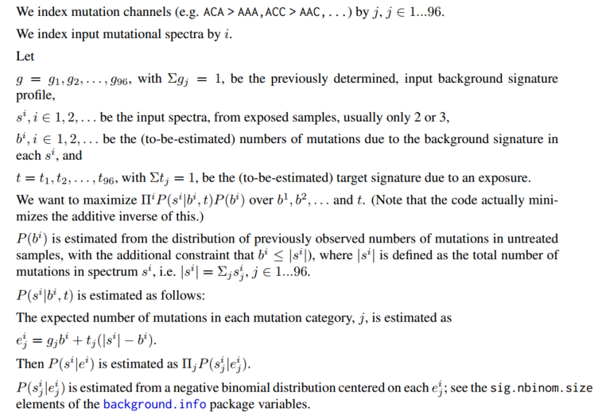
Practical exercise: Determining the level of background
Background levels can vary depending on the number of cell divisions
Therefore, we sample from a negative binomial distribution of levels of background, centered on what we observed in our controls.
Approach: Contribute a known background signature to each
observed spectrum, inferring the non-background signal.
Thus this doesn’t work with only a single spectrum.
Model:
Maximum likelihood model using numerical optimization.
From the manual of mSigBG:

Slide 48
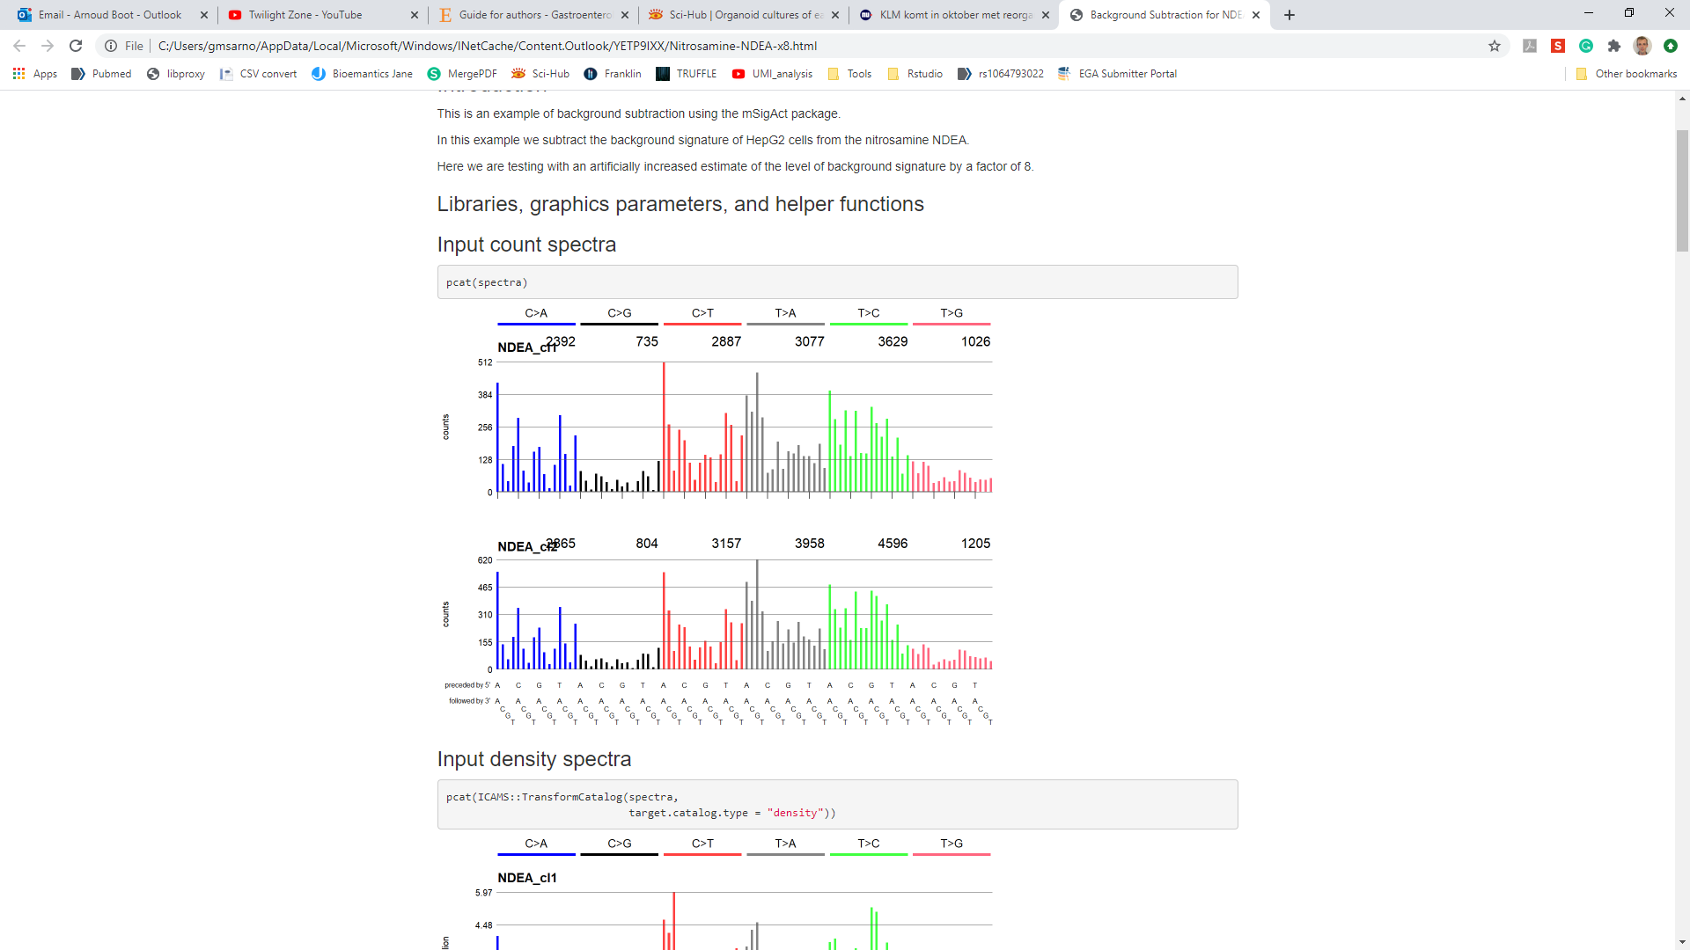
Example of background subtraction
Input spectra
Background spectrum

Slide 49
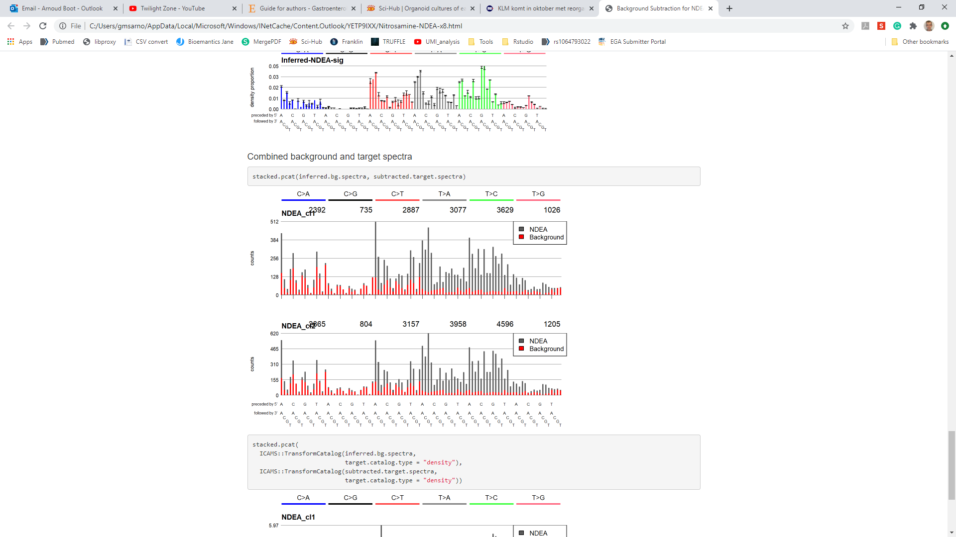
Example of background subtraction
Input spectra
Background spectrum
Background contribution

Slide 50
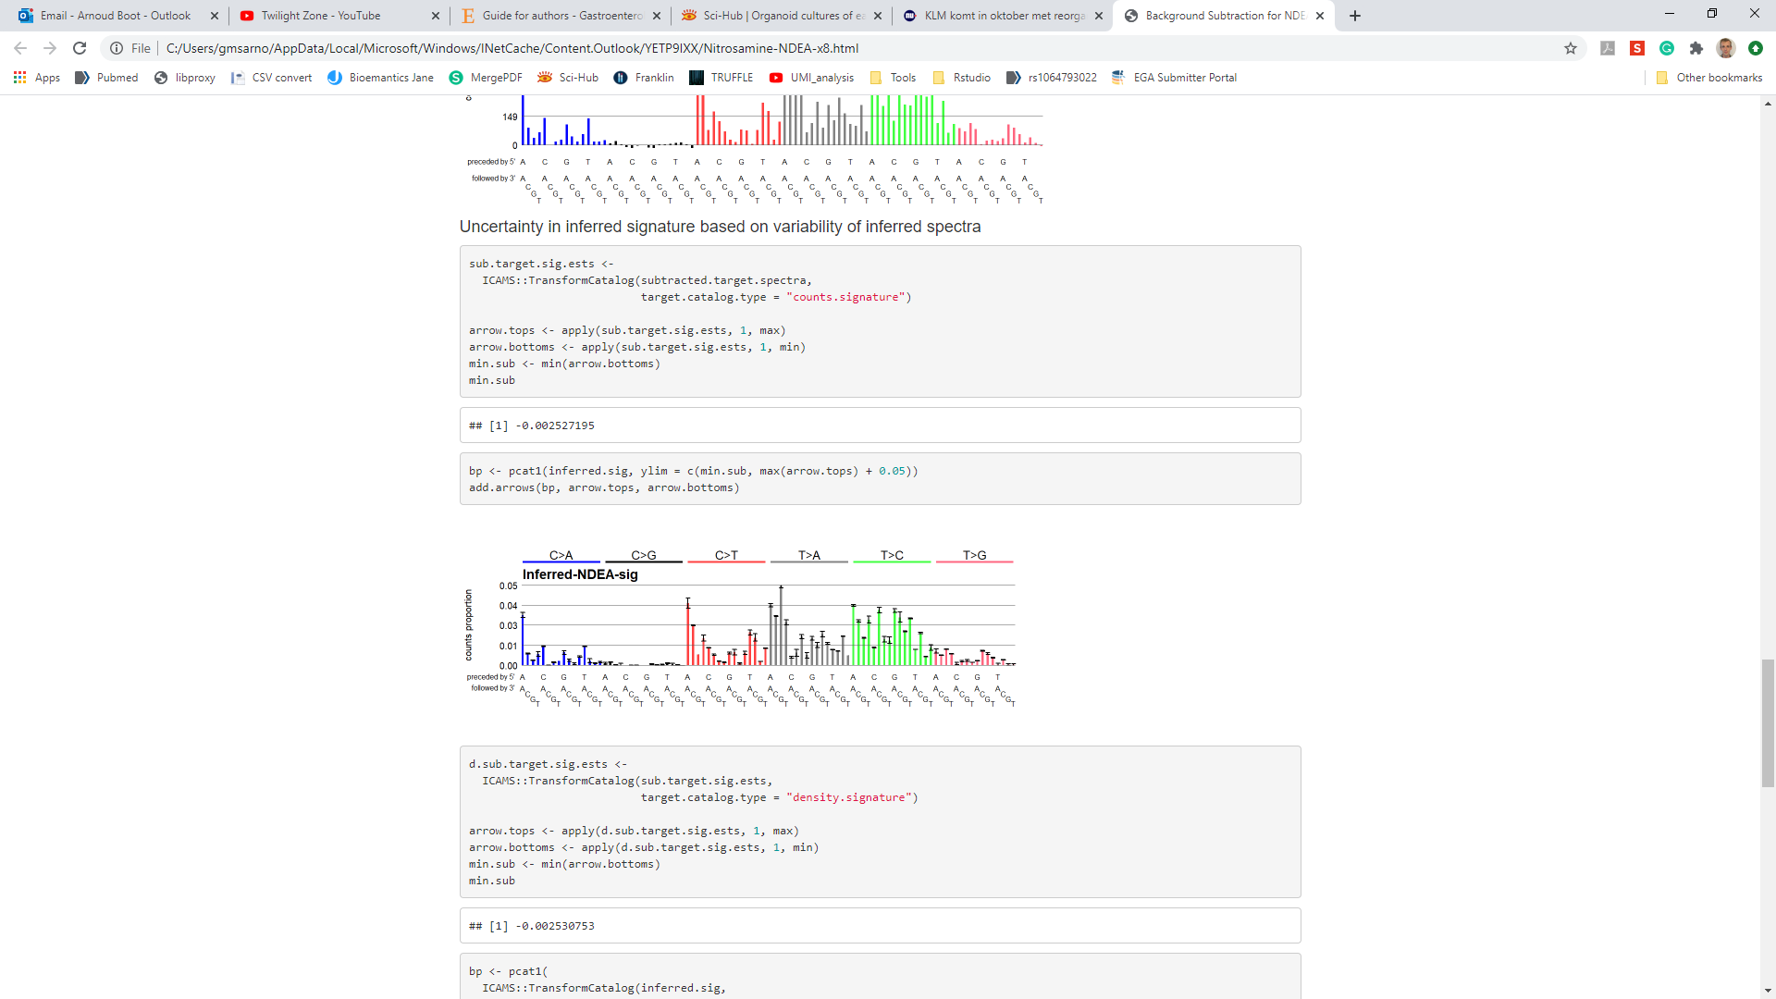
Example of background subtraction
Input spectra
Background spectrum
Background contribution
Inferred signature

Slide 51
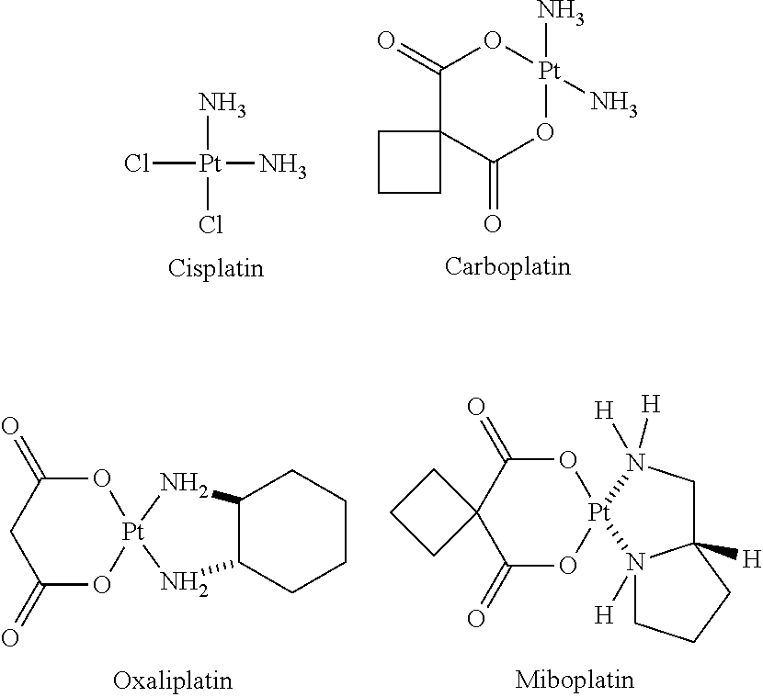
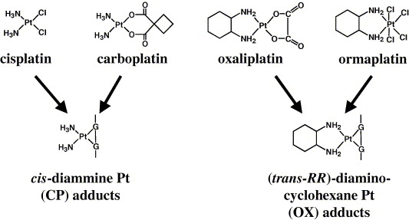
Practical exercise: Cisplatin analogues
WGS of cell lines exposed to Cisplatin, Carboplatin and Oxaliplatin
Cisplatin and carboplatin form identical DNA adducts

Slide 52
Practical exercise: analyzing experimental signatures data
Please refer to the word document “file.name.docx” for directions
Reconvene at 11:50

